Slide 1
Design and Analysis of Algorithms
Algorithms-II : CS345A
Website: hello.iitk.ac.in
Lecture 7
Proof of correctness of an algorithm - II

Slide 2
Recap of the previous lecture

Slide 3
Synchronizing a circuit
with minimum delay enhancement

Slide 4
An Electric Circuit
A complete binary tree
Electric signal originates at the root
Signal passing through each edge incurs a delay (a few nano seconds)
Finally signal reaches all the leaves.
Electric signal
6
5
3
2
4
2
2
1
6
2
1
2
3
2
Delay 11 10 14 10 10 11 10 9
14
10

Slide 5
Problem definition
Given:
There is a circuit in the form of a complete binary tree.
Electric signal propagates from root to all leaf nodes.
Each edge has certain delay
The delay in reaching signal to a leaf node =
“sum of delays on all edges on the path from root.”
Objective:
Enhance delay along certain edges so that
The delay on all paths from root to leaf nodes is the same.
Total delay enhancement is minimum.

Slide 6
The algorithm
Electric signal
Total delay enhancement: 14
6
5
+3
3
+3
2
4
2
+1
2
6
+4
1
1
2
+1
3
2
+1
+1
2
14
11
14
14
14 14 14 14
11
11
Delay 11 10 14 10 10 11 10 9
11
10

Slide 7








The algorithm
For each non-leaf node $u$ do the following:
$D_{L}(u)$: max delay along any leftward path
$D_{R}(u)$: max delay along any rightward path
If ($D_{L}\left(u\right)≥D_{R}(u)$)
increase delay of right edge by $D_{L}\left(u\right)$ - $D_{R}\left(u\right)$
Else
increase delay of left edge by $D_{R}\left(u\right)$ - $D_{L}\left(u\right)$
$$γ$$
u
$$α$$
$$β$$
$$+D_{R}\left(u\right)\text{ − }D_{L}\left(u\right)$$
$$+D_{L}\left(u\right)\text{ − }D_{R}\left(u\right)$$
$$D_{L}(u)$$
$$D_{R}(u)$$

Slide 8
Proof of correctness of the algorithm
What assertion suffices as a proof ?

Slide 9
What assertion suffices as a proof ?
Usually it is difficult even to find out the claim whose establishment captures the correctness of the algorithm.☹
In the current algorithm, what might be this claim ?
Let us have a re-look at the algorithm from point of view of a single node .

Slide 10
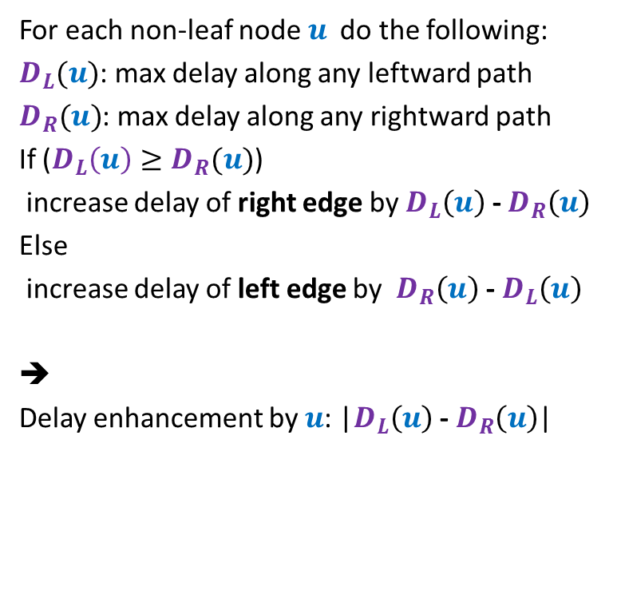



For each non-leaf node $u$ do the following:
$D_{L}(u)$: max delay along any leftward path
$D_{R}(u)$: max delay along any rightward path
If ($D_{L}\left(u\right)≥D_{R}(u)$)
increase delay of right edge by $D_{L}\left(u\right)$ - $D_{R}\left(u\right)$
Else
increase delay of left edge by $D_{R}\left(u\right)$ - $D_{L}\left(u\right)$
➔
Delay enhancement by $u$: |$D_{L}\left(u\right)$ - $D_{R}\left(u\right)$|
$$γ$$
u
$$α$$
$$β$$
$$+D_{L}\left(u\right)\text{ − }D_{R}\left(u\right)$$
$$D_{L}(u)$$
$$D_{R}(u)$$

Slide 11
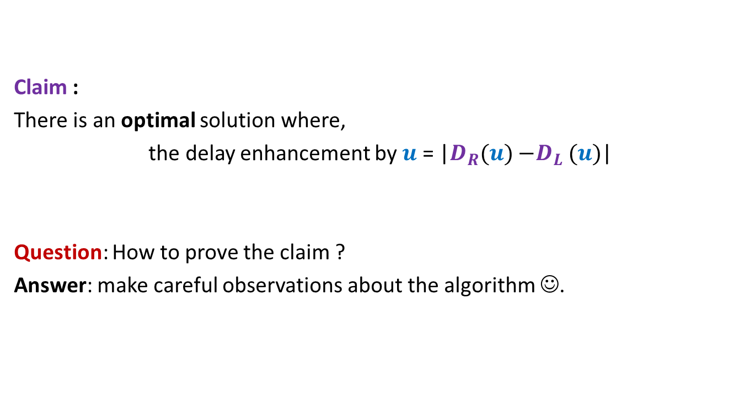
Claim :
There is an optimal solution where,
the delay enhancement by $u$ = |$D_{R}(u){−D}_{L}(u)$|
Question: How to prove the claim ?
Answer: make careful observations about the algorithm ☺.

Slide 12
Observations about the algorithm

Slide 13

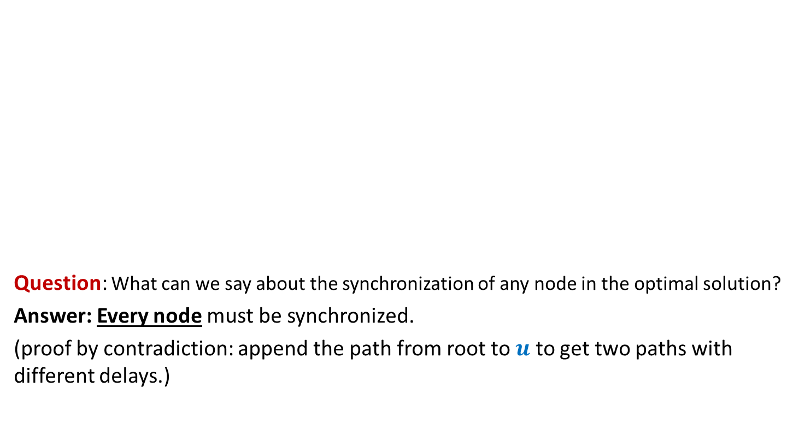


Observation 1
Electric signal
Question: What can we say about the synchronization of any node in the optimal solution?
Answer: Every node must be synchronized.
(proof by contradiction: append the path from root to $u$ to get two paths with different delays.)
$$u$$
$$δ_{1}$$
$$δ_{2}$$

Slide 14
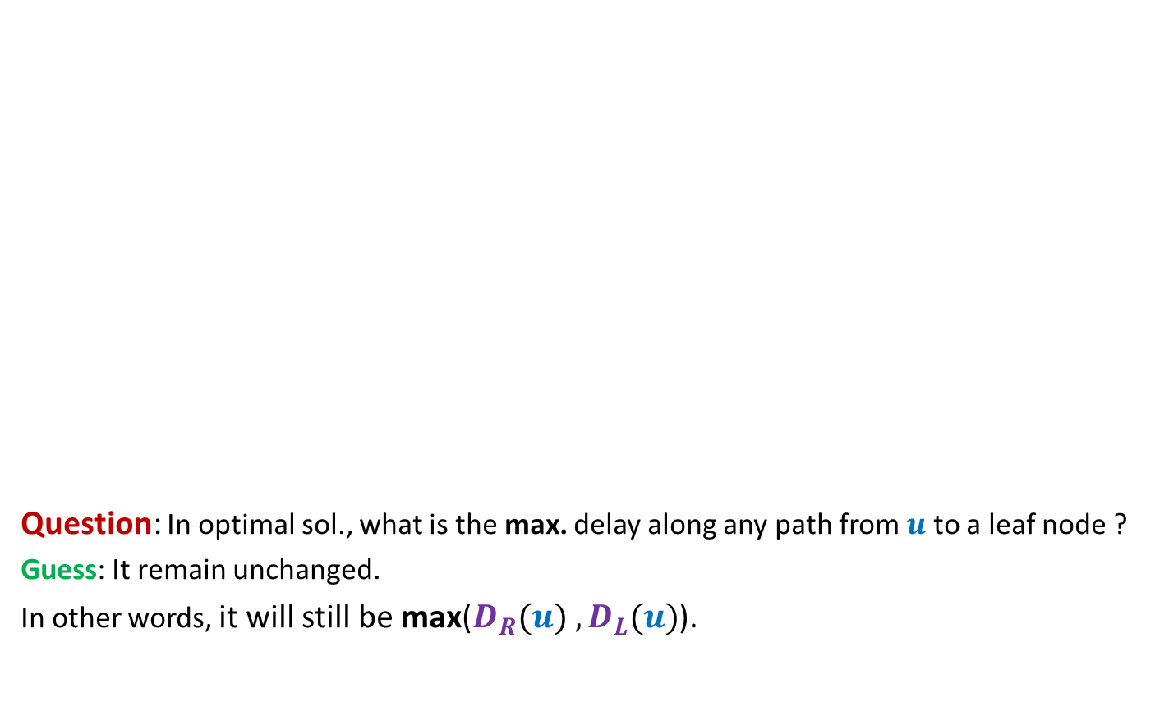
Observation 2
The maximum delay from the root to any leaf node remains unchanged in the optimal solution. What can we say about the maximum delay from any other node to any leaf node in its subtree?
Electric signal
Question: In optimal sol., what is the max. delay along any path from $u$ to a leaf node ?
Guess: It remain unchanged.
In other words, it will still be max($D_{R}(u){ ,D}_{L}(u)$).
$$u$$
6
5
+3
3
+3
2
4
2
+1
2
6
+4
1
1
2
+1
3
2
+1
+1
2
Delay 11 10 14 10 10 11 10 9
New Delay 14 14 14 14 14 14 14 14

Slide 15
Usefulness of the guess

Slide 16
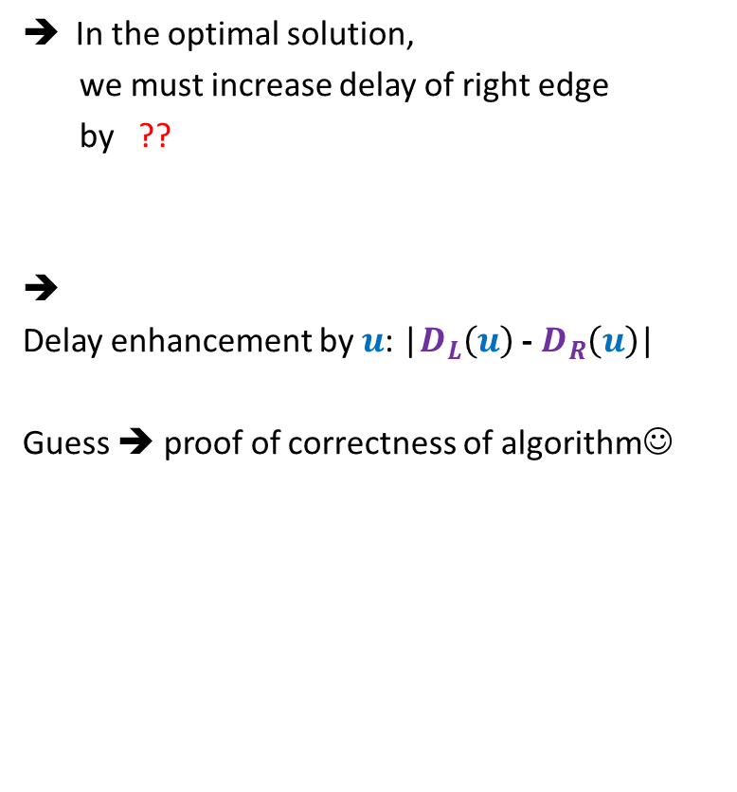



Usefulness of the guess
Suppose $D_{L}(u){≥D}_{R}(u)$
In the optimal solution,
we must increase delay of right edge
by ??
➔
Delay enhancement by $u$: |$D_{L}\left(u\right)$ - $D_{R}\left(u\right)$|
Guess ➔ proof of correctness of algorithm☺
How much enhancement ?
$$γ$$
How much enhancement ?
$D_{L}\left(u\right)$ - $D_{R}\left(u\right)$
u
$$α$$
$$β$$
0
$$+D_{L}\left(u\right)\text{ − }D_{R}\left(u\right)$$
$$D_{L}(u)$$
$$D_{R}(u)$$
unchanged
unchanged

Slide 17

Proving the guess
Guess : In the optimal solution, the delay along any path from $u$ to any leaf node is max($D_{R}(u){ ,D}_{L}(u)$).
Question: How to prove it ?
Answer: By contradiction.

Slide 18

What if the assertion fails at many nodes ?
Consider the lowest node in the tree where it fails.
In particular, any node with no red descendant will suffice.
(can you see why it is difficult to analyze any other “red” nodes ?)
$$u$$

Slide 19



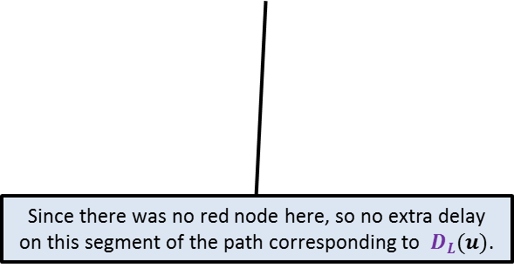


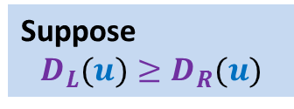



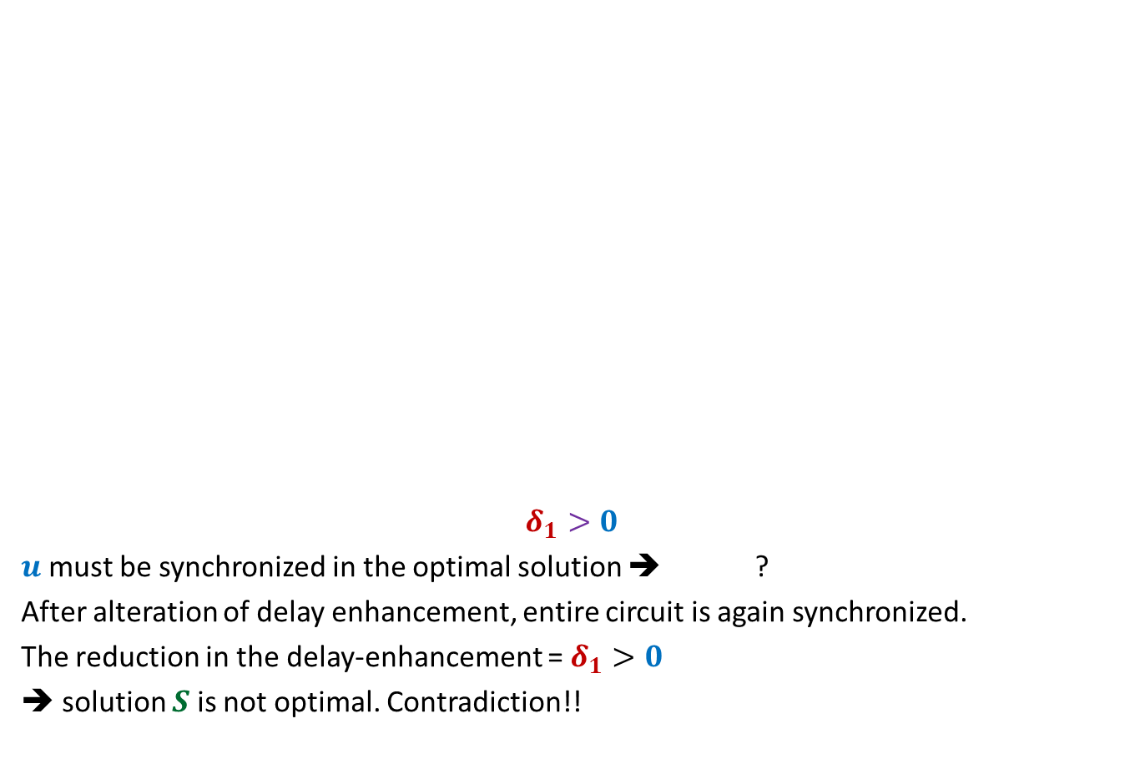













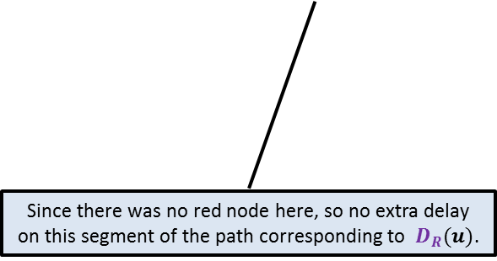
Proof:
the maximum delay on any path from $u$to any of its leaf node
is strictly greater than $D_{L}(u)$in an optimal solution $S$.
Suppose
$$D_{L}(u)≥D_{R}(u)$$
What does it imply ?
$$γ$$
$${+δ}_{3}$$
Can you do some manipulation to reduce the total delay enhancement ?
$$γ$$
What does it imply ?
$${+δ}_{3}$$
$${+δ}_{1}$$
$$u$$
$$u$$
$$δ_{1}>0$$
$u$ must be synchronized in the optimal solution ➔ ?
After alteration of delay enhancement, entire circuit is again synchronized.
The reduction in the delay-enhancement = $δ_{1}>0$
➔ solution $S$is not optimal. Contradiction!!
$$α$$
$${+δ}_{1}$$
$$β$$
$${+δ}_{2}$$
$$α$$
$$β$$
$${+D}_{L}\left(u\right)\text{ − }D_{R}\left(u\right)$$
$$+δ_{2}−δ_{1}$$
$$D_{L}(u)$$
$$D_{R}(u)$$
$$D_{L}(u)$$
$$D_{R}(u)$$
Since there was no red node here, so no extra delay on this segment of the path corresponding to $D_{R}(u)$.
Since there was no red node here, so no extra delay on this segment of the path corresponding to $D_{L}(u)$.
$$D_{L}(u)+δ_{1}=D_{R}(u)+δ_{2}$$

Slide 20
Efficient implementation of the algorithm

Slide 21
Efficient implementation of the algorithm
Electric signal
Delay enhancement: 14
6
5
+3
3
+3
2
4
2
+1
2
6
+4
1
1
2
+1
3
2
+1
+1
2
Delay 11 10 14 10 10 11 10 9
New Delay 14 14 14 14 14 14 14 14

Slide 22
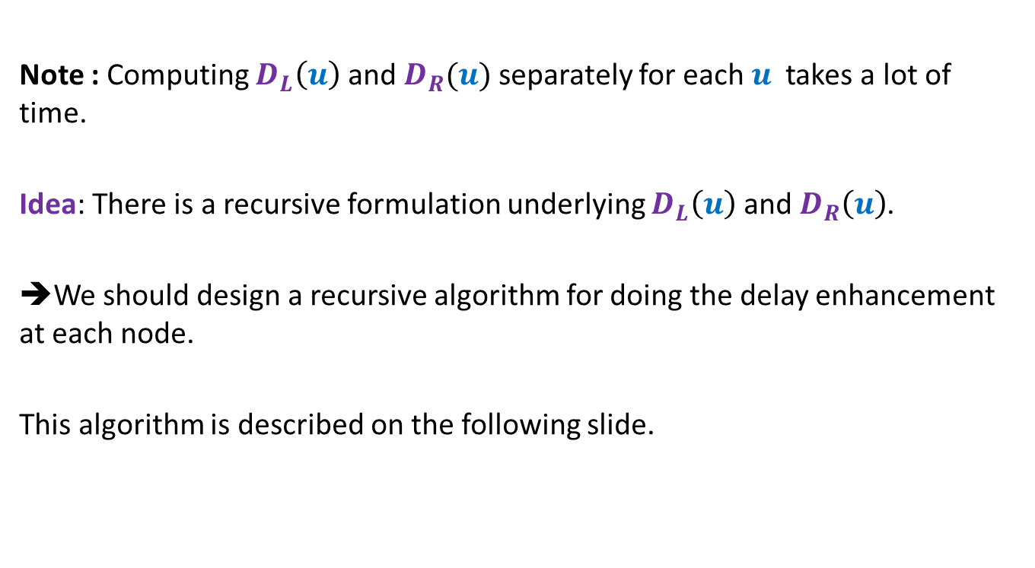
Efficient implementation of the algorithm
Note : Computing $D_{L}\left(u\right)$ and $D_{R}(u)$ separately for each $u$ takes a lot of time.
Idea: There is a recursive formulation underlying $D_{L}\left(u\right)$ and $D_{R}\left(u\right)$.
➔We should design a recursive algorithm for doing the delay enhancement at each node.
This algorithm is described on the following slide.

Slide 23
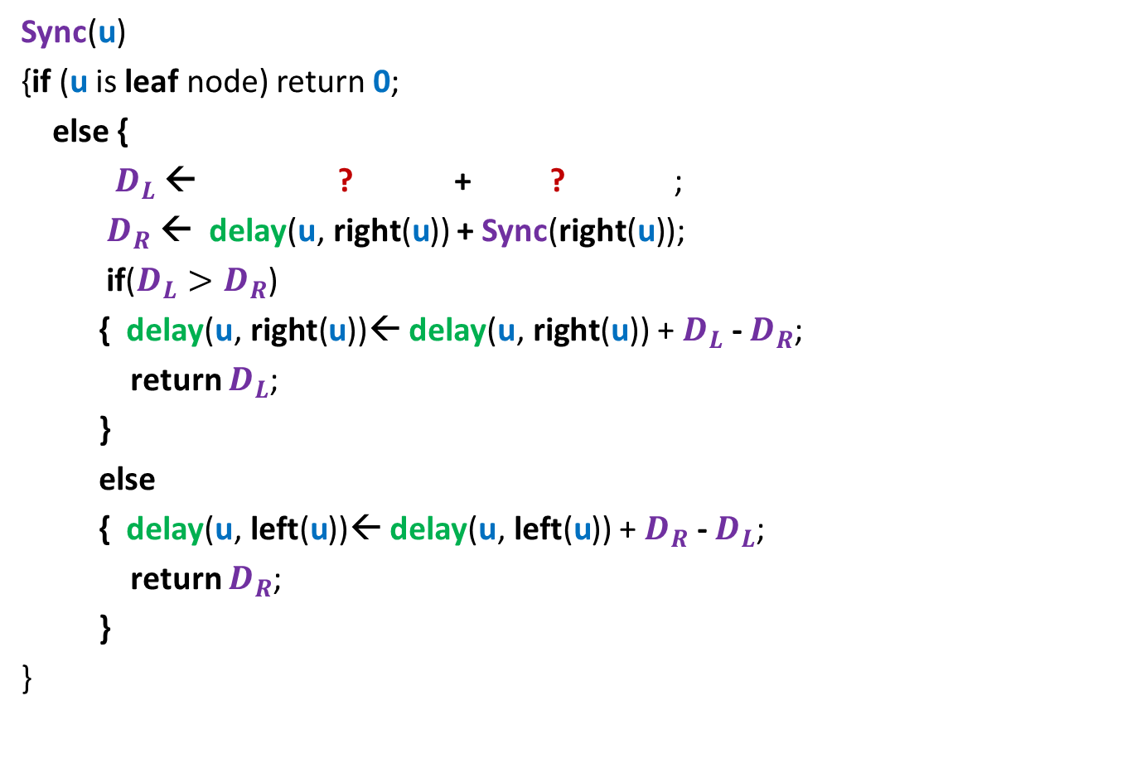



Sync($\text{u}$): A synchronization algorithm
Sync($\text{u}$)
{if ($\text{u}$ is leaf node) return $\text{0}$;
else {
$D_{L}$ ← ? + ? ;
$D_{R}$ ← delay($\text{u}\text{,} \text{right}\text{(}\text{u}$)) + Sync($\text{right}\text{(}\text{u}\text{)}$);
if($D_{L}>D_{R}$)
{ delay($\text{u}\text{,} \text{right}\text{(}\text{u}$))← delay($\text{u}\text{,} \text{right}\text{(}\text{u}$)) + $D_{L}$ - $D_{R}$;
return $D_{L}$;
}
else
{ delay($\text{u}\text{,} \text{lef}\text{t}\text{(}\text{u}$))← delay($\text{u}\text{,} \text{left}\text{(}\text{u}$)) + $D_{R}$ - $D_{L}$;
return $D_{R}$;
}
}
u
delay($\text{u}\text{,} \text{left}\text{(}\text{u}$))
Sync($\text{left}\text{(}\text{u}\text{)}$)

Slide 24

Theorem:
The algorithm Sync($\text{u}$) synchronizes the circuit with minimum enhancement in the delay.
Running time : linear in the size of the circuit.

